Slide 1
An Introduction to PS2 Development Under Linux
Course 2
PS2 Lecture Series

Slide 2
Overview
About Linux
Terminals
Windows File Sharing
Command Shell
Configuration Files
File Managers
Useful Tools
Sony tools overview
Debugging with ee-gdb / DDD / KDbg

Slide 3
About Linux
Linux is UNIX
Terminal TTY interface
XWindows interface
Notes:
Linux is a form of UNIX, UNIX is a trademark of AT&T and what people call UNIX is really any operating system conforming to the Portable Operating System Interface for uniX (POSIX).
Linux has two types of interfaces: using a TeleTYpe (TTY) or the X Window system. A tty interface is purely textual with special control codes for communicating non-text data. The X Window system is a network transportable client-server windowing system similar to Microsoft Windows.

Slide 4
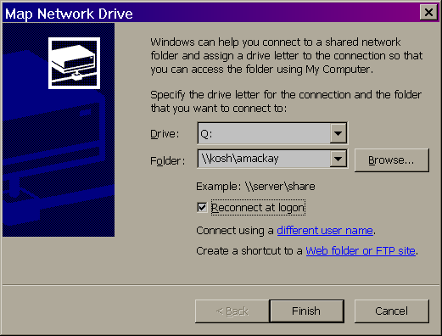
Windows File Sharing
Mapping your home directory
Differences in line termination
Notes:
To map a network drive open Windows Explorer and select “Tools:Map Network Drive”.
A key thing to remember when using a windows editor to edit code on a Linux machine is that the line terminators are different from on each system. Any editor that is worthy of writing code with should support all three types of line termination (UNIX, DOS and Mac).
Unfortunately it can be hard to tell if a text file is in DOS or UNIX text. If you use vim (vi is just an alias for vim on many Linux systems) then you can use the command “:set ff” to see the file format. You can also use the command “:set ff=unix” to ensure that it is in UNIX text.
Many systems will also have a command “dos2unix” which will turn DOS text in to UNIX text, this utility is often missing though. In a pinch you can always use the translate program “tr”. To convert DOS text to UNIX text all you have to do is remove any “\r” characters, this can be done with the command “tr -d ‘\r’ file1 > file1.tmp; mv -f file1.tmp file1”.

Slide 5
Command Shell
Types of shells
  bash, tcsh
Environmental Variables
  export, setenv
  PATH
  DISPLAY
  EDITOR
Notes:
The original UNIX shell, the Bourne shell (called “sh”) was once the only available shell. Then back in the early 80’s Bill Joy of Sun Microsystems created the C shell (called “csh”) and used it as the default shell for SunOS. The C shell was largely incompatible with the Bourne shell. This began the two families of shells, ones derived from the Bourne shell (such as the Korn shell, ksh, and the Bourne Again SHell, bash) and ones derived from the C shell (tcsh).
I highly recommend using only Bourne shell derived shells. The C shell provided several nice features for interactive use (all of which have been incorporated in to bash) but had some fundamental limitations which limit its usefulness. The default shell under Linux is bash, a very good shell.
The two families of shells have different syntax for setting Environmental Variables. Bash uses the form “export name=value” and csh uses the form “setenv name value”.
The PATH variable is a colon separated list of directories to check for executables, similar to the PATH in Windows. The main difference with the UNIX PATH is that the current directory (“.”) is not implicitly searched
The DISPLAY variable is used for the X Window system and tells programs where to display the interface. The form of this variable is “<machine name>:<Xserver number>”.

Slide 6
Configuration Files
Stored as “dot” files in your home directory
Comparable to .INI files under Windows or the registry
Your shell configuration file
  For bash ~/.bashrc
  For csh ~/.cshrc
Notes:
Most programs store there configuration in what are known as “dot” files in your home directory.
The most common one to need to edit is your shell configuration file so that you can define certain environmental variables.

Slide 7
Basic Commands
Copy: cp
Move/rename: mv
Delete: rm
View a file: more
Edit a file: pico or vi
Lookup a command in the manual: man
Command switches use “-” instead of “/”
The directory slash is “/” instead of “\”
Notes:
Most of the commands found under windows have similar counterparts under Linux.
Most commands under Linux will print a quick help message if given the flag “--help”.
Pico and vi are TTY based editors for quick file editing such as the DOS edior “edit”.
Vi is the traditional UNIX editor, its name comes from it’s heritage. It started as a fancy version of another editor “ex” that only edited lines at a time, from ex you could go in to visual mode with the “:vi” command.
Although vi is a very hard editor to learn it is also very powerful and elegant. If you want to be truly adept with UNIX you should learn to at least do simple file editing with vi.
The “man” command can also be used to key word search through the man pages using the form “man -k <keyword>”.

Slide 8
Advanced Commands
Find: the find command
  find . -name ‘*.cpp’ -o -name ‘*.h’
Search: grep (or G/Re/P)
  grep regularExpression file1 file2 file3
  fgrep expression file1 file2 file3
Diffing two files: diff file1 file2
Regular Expressions
  Use “\” to escape special charecters
  For more info: man 7 regex
Notes:
The find command is very powerful and has a very long list of switches, the man page should be used for further information.
The name grep comes from an old UNIX program that used the syntax “g/re/p” to mean global / regular expression / print, which is basically just a way to search text.
Regular expression are not simple and if you want to learn more about them you should try a book on them or the man page for them. The basic uses are the “*”, meaning zero or more of the previous atom (an atom is a regex unit, such as a single letter or a string if it is enclosed in braces) and the “.” meaning match any character. There are also anchors that are very useful, the most common being the start of line “^” and the end of line “$”.
An example of a regex: “^int.*foo *(“ would find the word “int” at the start of the line with the word “foo” in that line followed by any number of spaces and then an open brace.

Slide 9
Pipelining and Re-direction
Chaining two commands together
  diff foo.cpp foo.cpp-rev0.1 | grep ‘changed value’
Re-directing stdin, stdout and stderror
  put both stdout and stderr into a file: command >& file.out
  ignore stderr: command 2> /dev/null
  use file1 as input to a command: command < file1
  putting stderr into stdout and then stdout into a pipe: command 2>&1 | more
Notes:
Pipelining works much the same way it does in DOS except under UNIX it is actually very useful.
Stdin, stdout and stderr are the three standard file stream s that all programs are given on startup. The file descriptors used for them are 0, 1 and 2 respectively. Any file descriptor can be redirected with the syntax “n>” where n is the number.
Several of these examples are for bash only and will not work with csh.

Slide 10
Shell Expansion
Globbing: *, ? and []
Command substitution
  grep someVariableName `find . -name ‘*.cpp’ -o -name ‘*.h’`
The use of “ls *.h”
Variables
  echo $PATH
Quoting and escaping
  echo \$PATH
Notes:
Globbing is performed by the shell instead of the application.
When you execute “ls *.h” the shell is really executing the command “ls file1.h file2.h file3.h” for you.
Variable values are expanded with the “$” or “${}” if you require something like “echo ${varName}hahahah”.
All escaping is done as it is in C, typing “echo \$PATH” would produce the output “$PATH” exactly.
Most modern shells do user expansion as well, this is done with the “~” signifying your home directory and “~username” signifying the user with “username”s home directory.

Slide 11
Process Management
To view which processes you have running: “ps gxw”
To end a process: “kill <pid>” or “killall <proc name>”
To view the most active processes use the “top” command
For GUI process management use “gtop” or “ktop”
Notes:
A sample process listing:
(amackay@kosh)~/tmp$ ps gxw
PID TTY STAT TIME COMMAND
1378 tty1 S 0:26 kfm
1394 tty1 S 0:36 xterm
1452 pts/0 RN 127:45 xearth -pos fixed,20,-60 -nice 19
1485 pts/0 S 0:14 xterm
1487 pts/1 S 0:00 bash
To kill the last shell listed above the command “kill 1487” could be used.

Slide 12
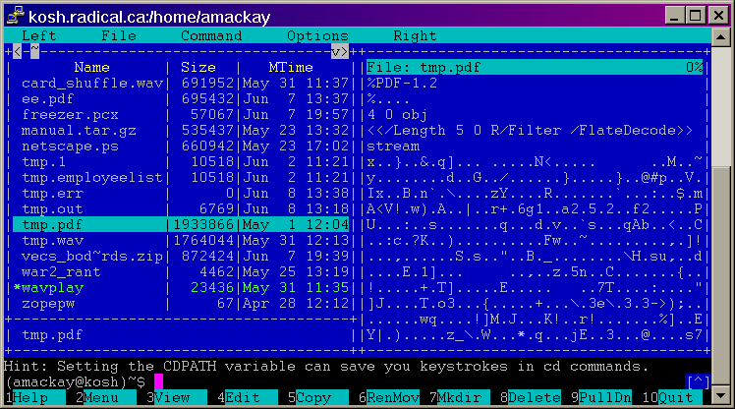
Midnight Commander
Notes:
If any of you have used the original “Norton Commander” or any of the other clones then Midnight Commander will be very comforting to you.
Midnight Commander gives a very powerful interface to the file system that is also easy to use. With it you can do most file operations and view/edit/get info/get directory size/search for files and much more.

Slide 13
Using Midnight Commander
UNIX escape and function keys
Switching panes
Envoking menus
Using the editor
Notes:
The TTY interface only allows certain keys through it, extra keys such as the function keys are not allowed through. To overcome this problem escape key sequences are used, these are a sequence of keys beginning with the escape key. This is all handled for you (if you terminal will pass function keys) but it does have the side effect of requiring you to hit escape twice to generate an escape.
If your terminal does not pass function keys then you can access the menus in Midnight Commander by generating the key sequences your self, simply hit escape followed by the menu number you wish to use.
The TAB key is used to switch panes in Midnight Commander, it is often important to ensure that the correct pane has the focus if one of the panes is a viewer or editor.
The menu items can be accessed with the F9 key and then the arrow keys.
The built-in editor in Midnight Commander is very easy and straight forward to use.

Slide 14
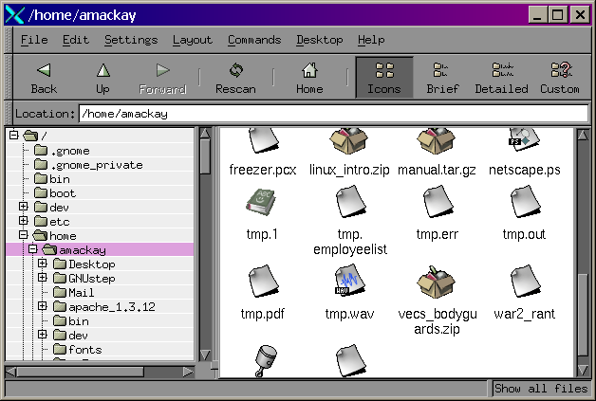
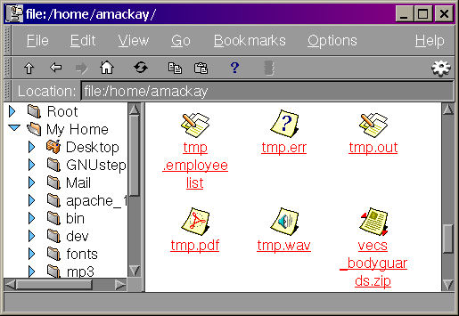
GUI File Managers
Gnome midnight commander
K file manager
Notes:
Both of these GUI file managers provide a very powerful means of accessing the file system.
Both of these file managers were designed to be run from some Desktop management system (such as gnome-session or startkde) but they are still very useful as stand alone programs. To run them simply open a terminal for them and run them in the foreground. This will allow you to quit them as they are not designed to be quit directly. If you don’t run them this way then they will continue to run after you log out and eventually saturate all available swap space on the Linux box. To stop them use control-C in the terminal that they are running.

Slide 15
Perforce
The “p4” command
  Set the environmental variable “P4PORT”
    export P4PORT=sv060:1673
  Set the environmental variable “P4CLIENT”
    export P4CLIENT=amackay-kosh
  To sync your depot: “p4 sync”
  To add a file: “p4 add file1”
  To edit a file: “p4 edit file1”
  To submit your changes: “p4 submit”
Notes:
Set the EDITOR environmental variable to the editor of your choice and it will be used for all p4 edits. If you want to use a different editor for p4 only you can set the P4EDITOR variable and that will be used instead.
To see help for the p4 command simply execute it with no arguments.
If you have several different perforce servers that you may need to access you can create shell files that set the P4PORT variable in the root of your local depots (or where ever you want) and then source those files to switch to that perforce server. To source a file under a shell use the command “source file1”.

Slide 16
GUI Editors
Nedit
Gvim
Emacs
Notes:
Nedit is a good choice of editor for people used to windows editors. It provides some powerful features and is easy to use.
Gvim is the GUI version of vim. Vim is VI iMproved, a much improved version of the classic vi editor. Gvim is powerful and elegant with a steep learning curve. One of the nicest things about taking the time to learn vim is the fact that it runs on every OS that has a C compiler, this means that you don’t have to spend lots of time learning a new editor every time you change platforms. The vim home page is http://www.vim.org.
Emacs is the kitchen sink of editors. It is very powerful but some of the key sequences can lead to carpal tunnel syndrome :-)

Slide 17
The Sony PS2 development tools
Sony provides a number of linux tools for PS2 development
  GCC: A C and C++ compiler suite including EE and VU assemblers
  GBD: The Gnu debugger, a very powerful debugger, but with a simple command-line interface
  Make: The Sony tools include Gnu make, even though it’s commonly available on most linux systems

Slide 18
Sony tools (Continued)
  DSNET: A suite of tools for communication with the PS2 DevStation including
    dsreset reset client
    dsstat status client
    dsedb EE debugger
    dsecons EE console server
    dsefilesv EE file server

Slide 19
Debugging on the PS2
The hard way: dsedb
$ dsedb # Start up the debugger
dsedb S> help # Display command help
dsedb S> pload main.elf # Load a program
dsedb S> bp main # Set a breakpoint at main
dsedb S> run # Execute the program
at=00010000 v0=...
dsedb S> db 0x100000 # Dump address 0x1000000
dsedb S> step # Step execution
dsedb S> dr # Display registers
dsedb S> reset # Reset target
dsedb S> quit # Terminate dsedb
$

Slide 20
Debugging on the PS2
The other hard way: ee-gdb
$ ee-gdb main.elf # Start up the debugger
(gdb) help # Display command help
(gdb) load # Download program to PS2
(gdb) break main # Set a breakpoint at main
(gdb) run # Execute the program
Breakpoint 1: main...
(gdb) step # Step execution
(gdb) print object->data # Print variables
(gdb) list myfunc # Show source
(gbd) quit # Terminate gdb
$

Slide 21
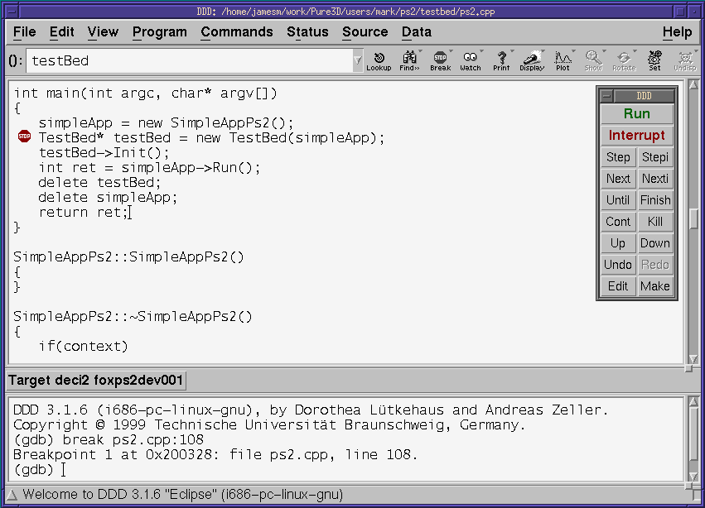
Debugging on the PS2: DDD
Notes:
Start ddd like this:
$ ddd --debugger ee-gdb target.elf
It also helps to have the following .gdbinit file:
define hook-run
target deci2 ps2
reset
load
end

Slide 22
Points to Take With You
Linux is UNIX and UNIX is a very powerful and well designed system that is worth the time to learn but often not very easy to learn.
Watch out for line termination differences as the errors that they produce are often non-intuitive.
Use the environment that suits you best, most things can be done from windows if you use a good text editor and map your home directory. It is still good to know your way around the shell in a pinch though.
Notes:
The design philosophy of UNIX is very old and very good. It tries to accomplish things in a modular way through generic interfaces, a technique quite common in software development today. Because of this it can be less than user friendly at points. Once you understand some UNIX things others will start to make a lot more sense.
An example of DOS text errors in a makefile would be:
(amackay@kosh)~/tmp$ make
', needed by `all'. Stop.target `
for the makefile of:
all :
@echo hello world
Not very intuitive is it.

